Slide 1
Calendar App
Submitted by Aditi Srivastava

Slide 2
1. Project Overview
A personal calendar app with REST and CLI interfaces.
Allows users to create and query scheduled events.
Time zone-aware design for accuracy across locales.
Includes a simple HTML/Bootstrap frontend.

Slide 3
2. Key Features – What the App Supports
Add new events with title, start, and end time.
List events for:
Today
Remaining part of the day
A specified date
Find next available time slots of specified duration.
Works across time zones.
Functional via REST API, CLI, and browser UI.

Slide 4
3. Why Time zone Support Matters
Users may be located in different time zones.
Events may be scheduled for another timezone (e.g., meeting in PST from EST).
Ensures events show up correctly in the user’s local time.
Prevents overlaps and scheduling errors when traveling or working globally.

Slide 5
4. Overall Architecture – High Level Design
It is a modular and layered architecture.
Model: Event class with validation and serialization.
Service: Business logic (CalendarService).
Storage: Persistence via file-based storage (can be swapped with database or in-memory implementation).
API: REST endpoints using Javalin.
CLI: Console-based interaction using Scanner.
UI: HTML/JS-based frontend.

Slide 6
5. Code Flow
Adding An Event
User provides title, start time, end time, and timezone.
Frontend/CLI sends request to backend.
EventFactory.fromRequest(…) validates input and creates Event.
CalendarServiceImpl.addEvent(...) checks for conflicts and saves, if valid.
Event is persisted to events.json via EventFileStorage.

Slide 7
5. Code Flow
Listing Events
User selects date and timezone.
API routes call CalendarServiceImpl.listEventsForDay(...).
Date is parsed and time zone is applied.
All events are filtered by matching time window.
Response is returned as a sorted list of events.

Slide 8
6. Why This Design Works - Extensibility & Maintainability
Extensible:
Storage layer (interface) allows plugging DBs or in-memory stores.
Timezone parsing uses Java’s native libraries – easily swappable.
Maintainable:
Each class has a single responsibility.
Event validation is centralized in EventFactory.
Testable:
Extensive JUnit 5 and Mockito-based unit tests..

Slide 9
7. Key Files & Folders – Code Organization
com.calendar.model: Event class.
com.calendar.api: REST endpoints (EventController).
com.calendar.service: Business logic (CalendarServiceImpl).
com.calendar.util: Utilities like DateTimeUtil and JsonUtil.
com.calendar.storage: Storage interfaces and file-based impl.
resources/public/calendar.html: Simple Bootstrap-based UI.

Slide 10
8. How to Run
Backend (REST):
mvn clean install package
java -jar target/calendar-app-1.0.0.jar
CLI Mode:
java -jar target/calendar-app-1.0.0.jar CLI
Frontend:
Open localhost:8081/calendar.html in your browser. Ensure backend is running on port 8000.

Slide 11
9. How to Test & Verify
Run all unit tests:
mvn test
Tests cover:
JSON utilities
Date parsing and timezone handling
Event creation/validation
Event service logic
Seed data can be added in events.json.

Slide 12
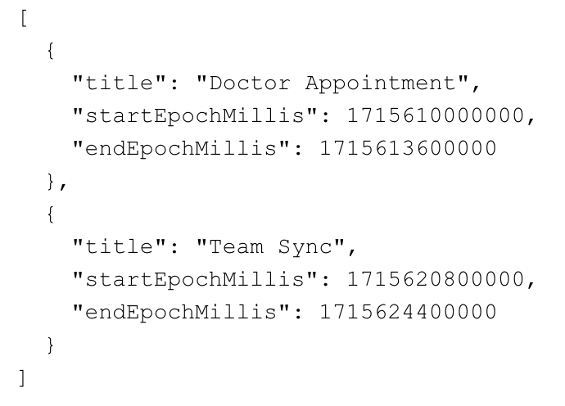
10. Sample Seed Data - Example events.json

Slide 13
10. Sample Seed Data - Example events.json (contd.)
Dynamic Seed Data Generator:
Features like “today’s events”, “remaining events”, and “next available slot” rely on the current date and time.
A static JSON file cannot adapt to real-time changes or demonstrate dynamic behavior.
The generator provides fresh, relevant seed data every time.
Trigger via UI or CLI.
Button on the frontend labeled “Generate Seed Data”
Calls a backend endpoint: GET /generate-seed-data
On success, events are saved to events.json and UI displays a confirmation message.

Slide 14
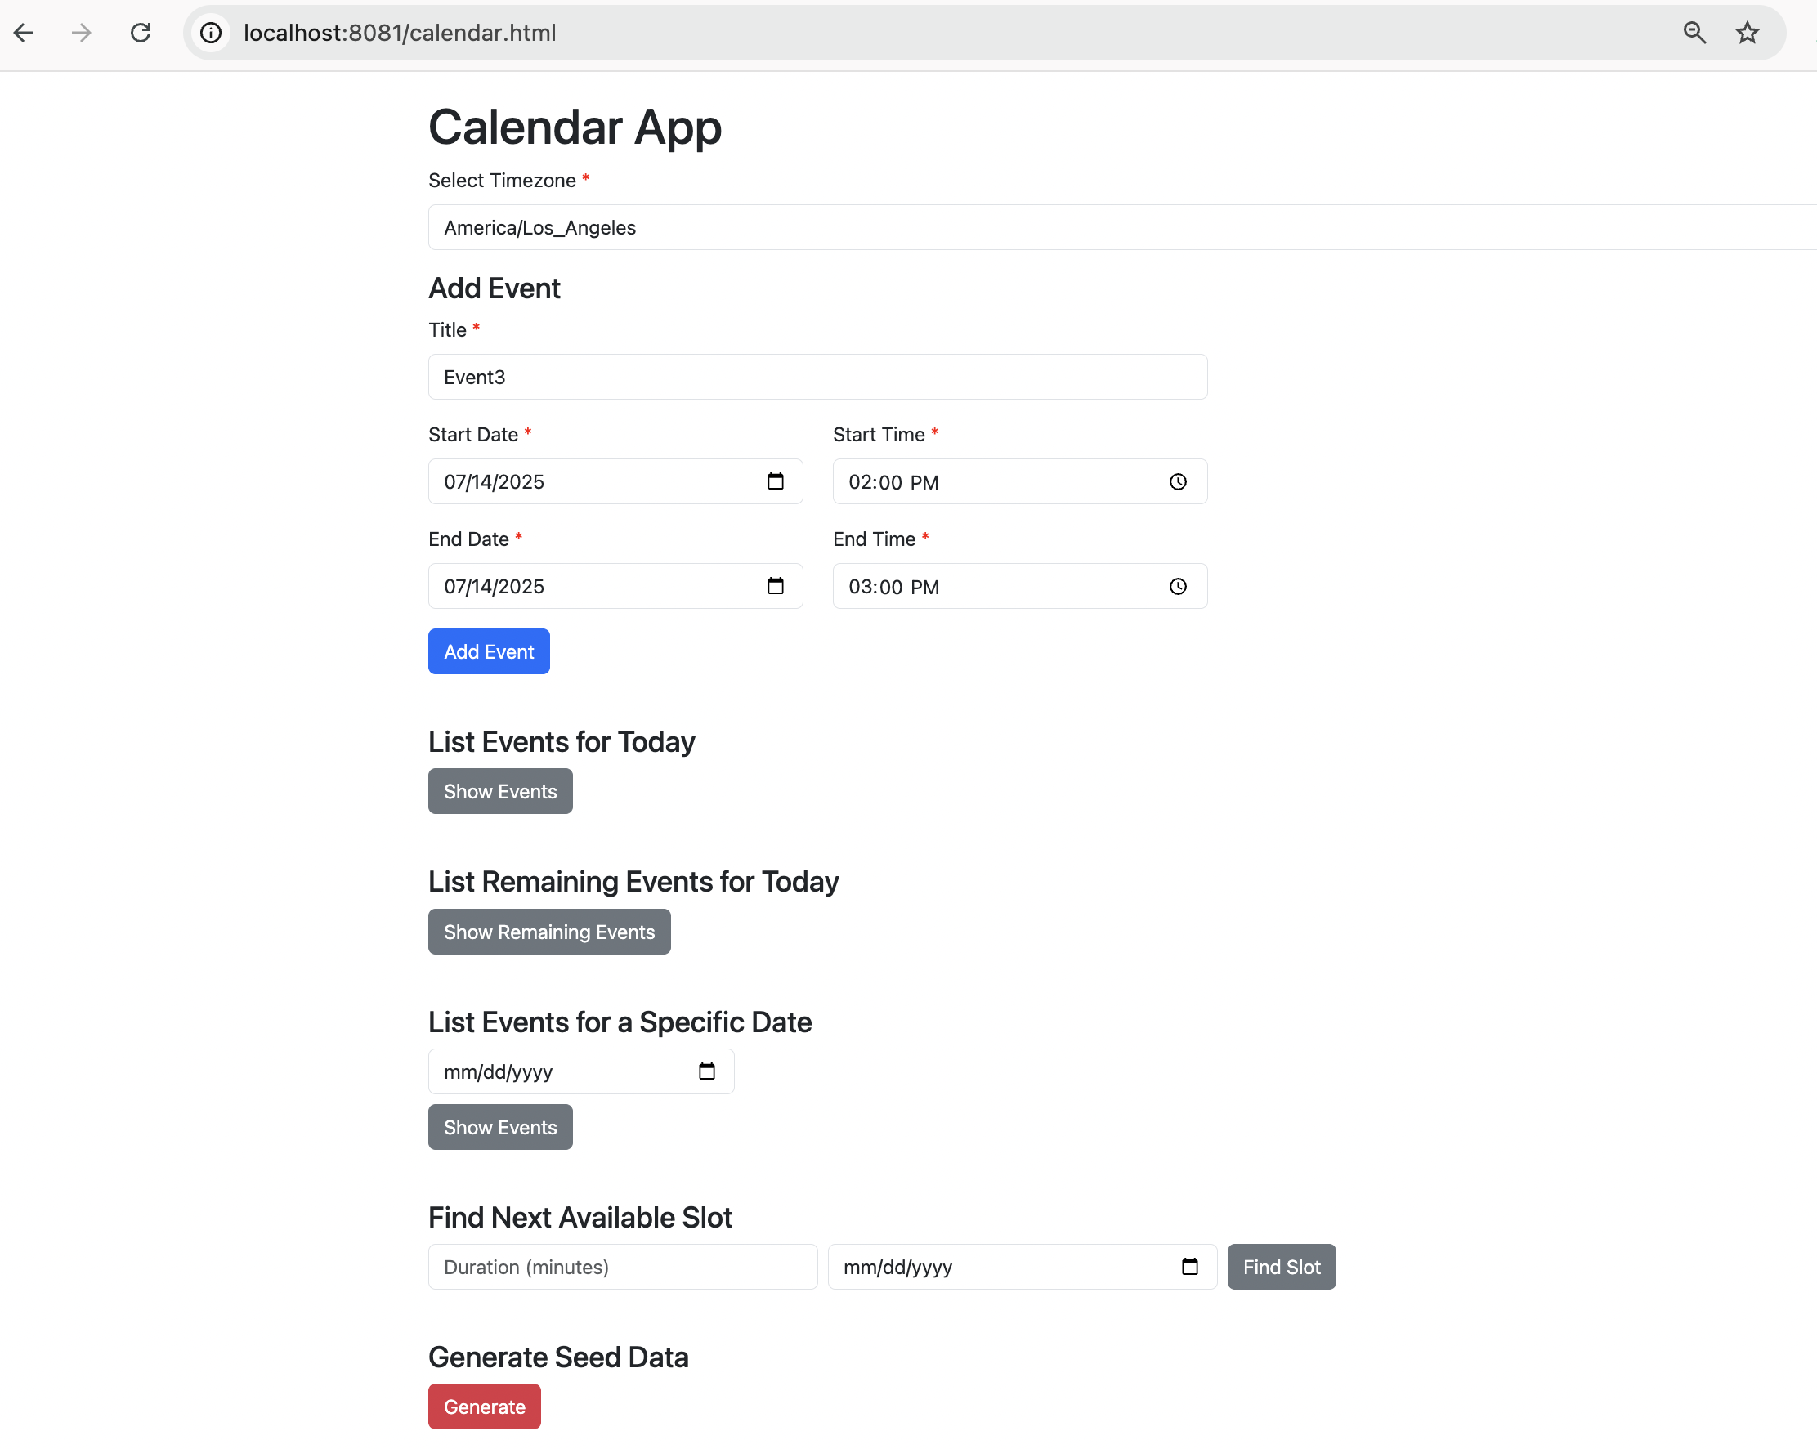
11(a). Screenshots – UI & CLI Snapshots calendar.html with form inputs

Slide 15
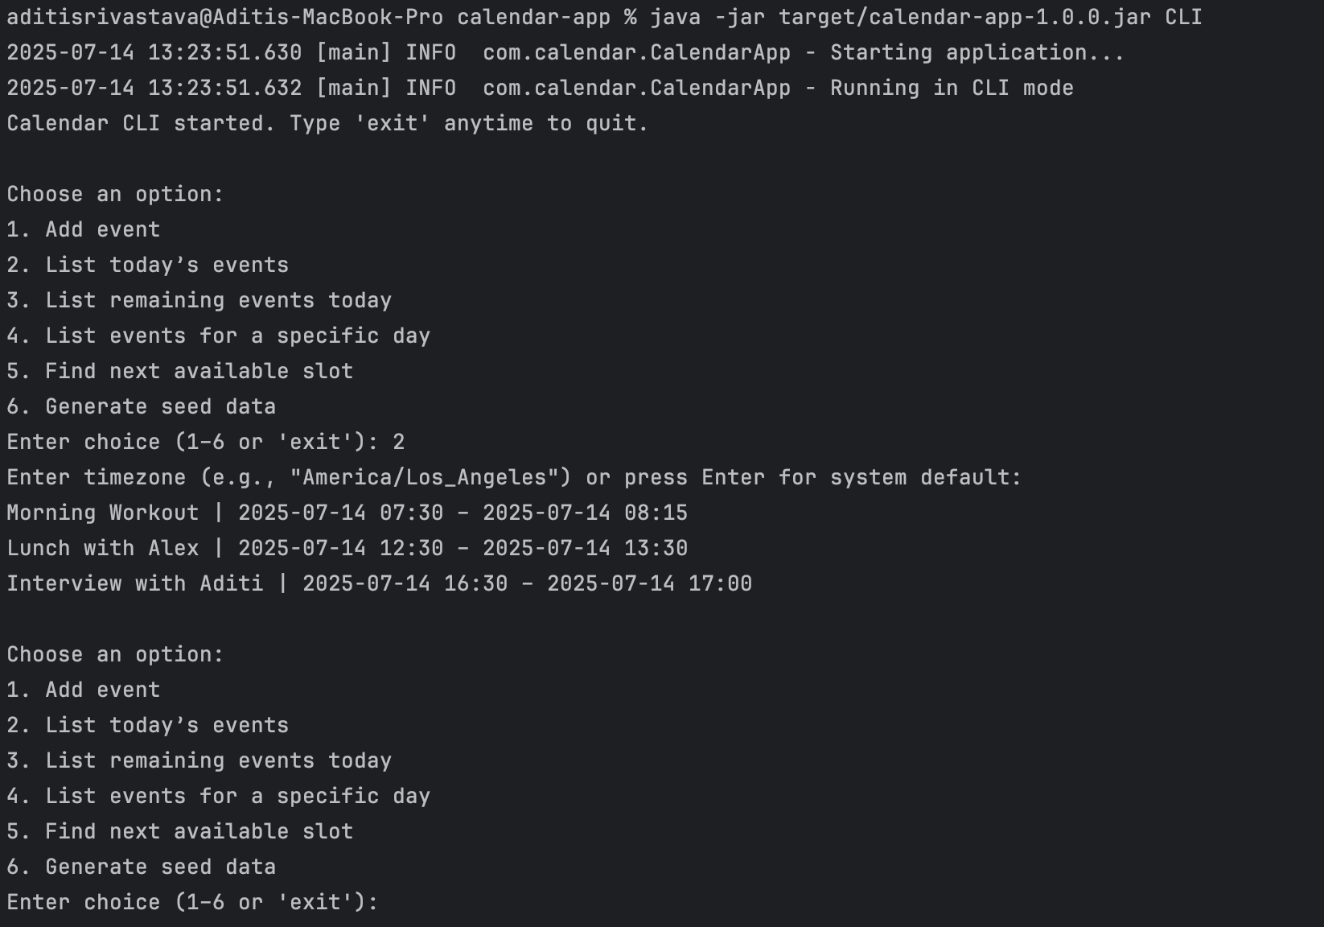
11(b). Screenshots – UI & CLI Snapshots CLI asking for event details

Slide 16
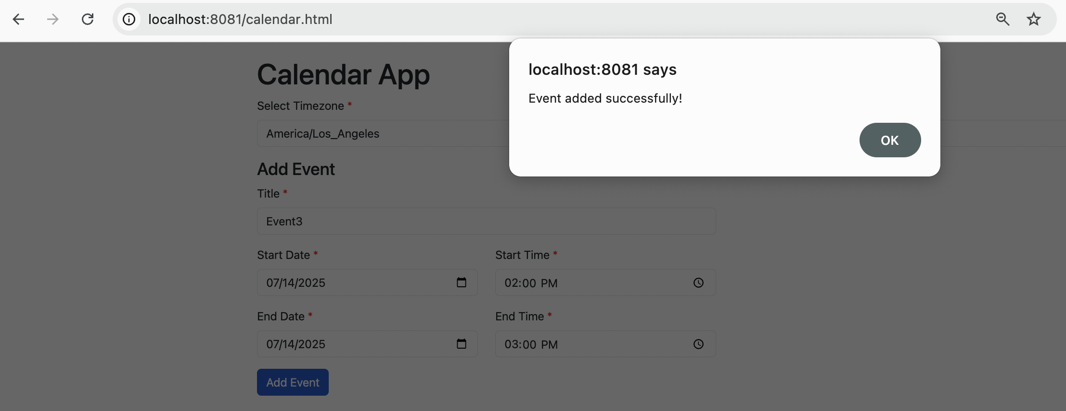
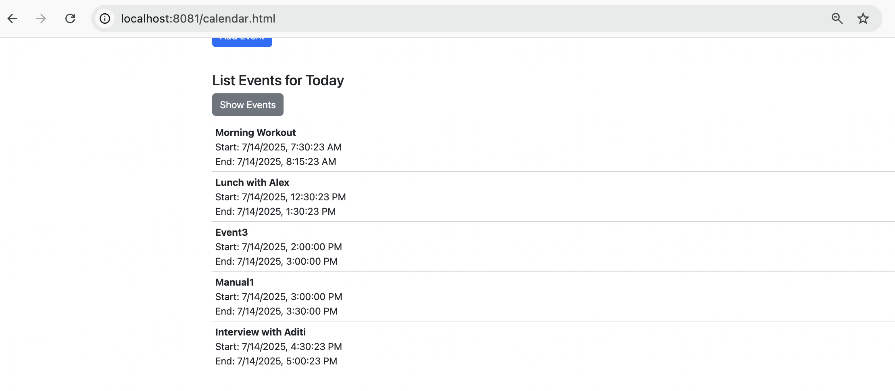
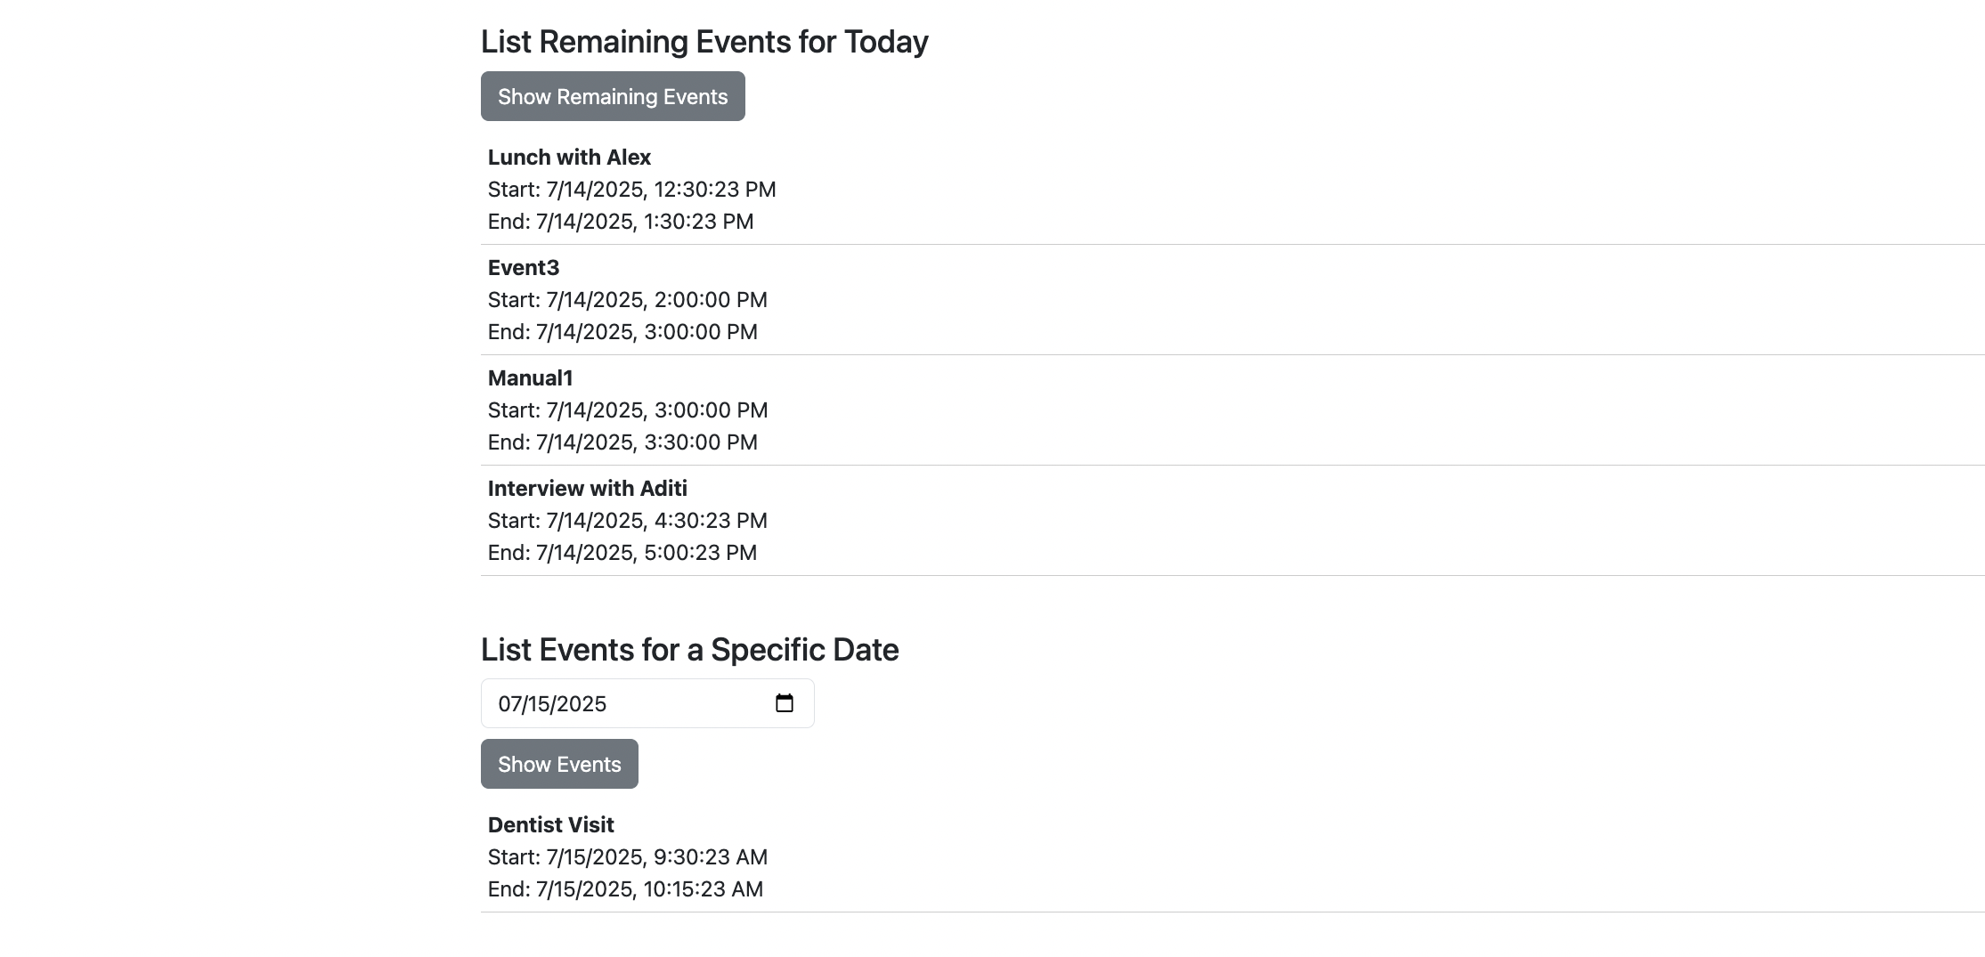

11(c). Screenshots – UI & CLI Snapshots REST API response in browser

Slide 17
12. Closing Thoughts – Final Notes
Timezone support ensures event accuracy.
Design enables easy future enhancements (recurring events, reminders).
Fully testable and portable.
Lightweight tech stack: Java 8, Javalin, Bootstrap, no frameworks.

